Slide 1
AN OVERVIEW OF
NETWORK VIRTUALIZATION
CS854: Virtualization
Mosharaf Chowdhury
Notes:
Hi everyone.
I am Mosharaf and I am going to provide an overview of the network virtualization landscape.
In this talk, I will focus on the basics of network virtualization based on our survey of the past, the present, and the future of network virtualization.
But first I would like to briefly reintroduce virtualization itself.

Slide 2
What is Virtualization?
Transparent abstraction of computing platform and resources
  Multiple logical interpretations of the physical characteristics
Additional level of indirection
  Indirect access to hardware
  Hides implementation details
  Controls mappings from abstract view to implementation
“Any problem in computer science can be solved
with another layer of indirection”
- David Wheeler
CS854: Virtualization
Notes:
So, what is virtualization?
Virtualization is a transparent abstraction of computing platform and resources which provides multiple logical interpretation of the underlying physical characteristics.
More to that, virtualization provides an increased level of indirection. <READ>
<Definition by Wheeler>
The simplest example is virtual memory. I bet all of us know about virtual memory in our computers.
Nowadays, due to the advancements in computing powers and resources, a tide of virtualizing every aspect of computing is taking place.
<Give examples>

Slide 3
Example: Virtual Machines
App A.1
App A.2
App A.3
App B.1
App B.2
App B.3
Operating System A
Operating System B
Virtual Machine 1
Virtual Machine 2
CPU
CPU
Mem
CPU
Mem
Net
Virtual Machine Monitor (VMM)
Physical
Machine
CPU
CPU
CPU
Mem
Net
CS854: Virtualization
Notes:
Virtual machines are good examples of virtualization
<Describe>

Slide 4
The Good,
Virtualization adds flexibility, allows heterogeneity, and improves manageability of the computing infrastructure
Lower cost of ownership
  Fewer computing resources
  More resilient and simpler to manage
CS854: Virtualization
Notes:
When and why should we use virtualization?
<Read>

Slide 5
The Bad,
Performance penalty
  Overhead due to the indirection layer
Too much abstraction
  Hidden details
CS854: Virtualization
Notes:
When NOT to use virtualization?
<Read>

Slide 6
And the Ugly?
CS854: Virtualization
Notes:
Clint Eastwood movie :)

Slide 7
Historical Perspective
CS854: Virtualization

Slide 8
Network Virtualization for Dummies
Making a physical network appear as multiple logical ones
Physical Network
Virtualized Network - 1
Virtualized Network - 2
CS854: Virtualization
Notes:
Here is the simplest definition of network virtualization, which I call the definition for the dummies.
Say, we have a physical network.
Network virtualization creates logical abstraction in such a way so that it appears as multiple logical networks.
Each of these logical networks is also known as a virtual network.
A virtual network can be a subset or a proper subset of the underlying physical network’s nodes and links.

Slide 9
Related Concepts
Virtual Local Area Networks (VLAN)
Virtual Private Networks (VPN)
Active and Programmable Networks
Overlay Networks
CS854: Virtualization
Notes:
The phrase “virtual networks” is not new though.
It has been used, misused and abused to describe many different and sometimes similar concepts in the past.
Well, it is harsh when I say abused but it should’ve been used for a broader context.
And we are going to do just that.
Anyway, there are three major categories of research in the networking field that are either directly or indirectly related to network virtualization.
First, virtual private networks or VPN.
A VPN is a private network provisioned by an ISP for a particular entity to connect its distributed sites.
The major problem of VPN is that the VPN customer is bounded by the protocols implemented by the provider and cannot customize the VPN.
Next is active and programmable networks.
In this case, users can customize the network through defined interfaces and by inserting active codes into the network.
The research did not fly because no one wanted to open their networks, and more importantly at that time it was technologically and economically infeasible.
Finally, the closest cousin of virtual network; overlay networks.
We have had so many works on overlay networks over the past few years, it should’ve been exhausted by now.
Overlay networks is application layer virtual networks; you can say a special case.
P2P networks are the best and the most popular examples of network virtualization.

Slide 10
Virtual Local Area Networks (VLAN)
Group of logically networked hosts
  Single broadcast domain
Advantages
  Ease of network administration and management
  Elevated levels of trust, security, and isolation
CS854: Virtualization

Slide 11
Virtual Private Networks (VPN)
Virtual network connecting distributed sites
  Works over public communication networks
VPN classification (based on the protocol used in the VPN data plane)
  Layer 3 VPN
  Layer 2 VPN
  Layer 1 VPN
CS854: Virtualization

Slide 12
Major VPN Classification
L3VPN
  CE-based VPN using tunneling
    Network is unaware
  PE-based VPN
    States in the network
L2VPN
  Agnostic to higher level protocols
  No control plane
L1VPN
  Rise due to advances in optical networking technologies
  Independent Layer 1 resource view, separate policies, and complete isolation
CS854: Virtualization
Notes:
Tunneling
Carrier protocol: IP
Encapsulating protocol: GRE, PPTP, L2TP, IPSec
Passenger protocol: original data

Slide 13
Active and Programmable Networks
Customized network functionalities
Active Networks
  Customization of network services at packet transport granularity
  More flexibility with increased security risk
Programmable Networks
  Defined programming interfaces
  More secured than active networks
Requires changes to existing hardware
CS854: Virtualization

Slide 14
Overlay Networks
Logical network on top of another existing network
  Internet was an overlay on the telecommunications network
Application layer virtual networks
Extravagantly used in the Internet
  Ensuring performance and availability of Internet routing
  Enabling Multicasting
  Providing QoS guarantees
P2P networks are overlays
CS854: Virtualization

Slide 15
Downsides of Overlay Networks
Largely used as narrow fixes for specific problems
  No holistic view
Most overlays are designed in the application layer
  Cannot support radically different concepts
Anderson et al.
CS854: Virtualization
Notes:
In the seminal paper “Overcoming the Internet impasse through virtualization”

Slide 16
Network Virtualization Environment
CS854: Virtualization

Slide 17
What is Network Virtualization?
Transparent abstraction of networking platform and resources
  Multiple logical interpretations of the physical characteristics
Additional level of indirection
  Indirect access to network resources
Resource partitioning and isolation
  Physical and logical
  Dynamic provisioning and configuration
CS854: Virtualization

Slide 18
Why Virtualize the Network?
Internet is almost ossified
  Lots of band-aids and makeshift solutions (e.g., overlays)
  A new architecture (aka clean-slate) is needed
Hard to come up with a one-size-fits-all architecture
  Almost impossible to predict what future might unleash
Why not create an all-sizes-fit-into-one instead!
  Open and expandable architecture
  Coexistence of heterogeneous architectures
CS854: Virtualization
Notes:
Before we jump into the bandwagon we must always make sure that we know the reason why do we want to do that.
The most well-known reason given by the proponents of network virtualization is that the Internet is ossified.
I would say almost ossified, cause it’s still working and working fine, isn’t it?
But why do we say the Internet is ossified ?
If we think about it we can see that the existing Internet is doing more than it was supposed to.
We are forcing it to stretch beyond its limit, and each time a new problem arises we solve that with some makeshift solution instead of looking into the reason that caused that problem.
The best example of such a band-aid is overlay based solutions; very effective, very fast but still superficial.
In fact, it is now impossible to resolve the root causes without disrupting everything even if we can find one such root problem.
So, the answer is no surprise.
We need a new architecture.
Such a new architecture must be able to solve the existing problems and should also be able to handle anything new that might come up in the unforeseen future.
Since it is impossible to predict the future, it is also impossible to create a universal architecture.
As a result, the best idea all the big names have managed to come up with is to create something that can accommodate all different sizes.
Something that is open, programmable, and hence expandable based on the future requirements.
And even if we are not that much concerned about the future, we should also virtualize the network to create testbed networks that can be used to test new architectures and protocols without hampering the existing ones.
The ones we have right now, for example PlanetLab, EmuLab, OneLab are not the best platforms we could’ve had.
I am not going to talk about their limitations, but just know that they have some and those cannot be avoided.

Slide 19
Network Virtualization Environment (NVE)
Virtual Network
Business Model
Principles
Architecture
Design Goals
CS854: Virtualization
Notes:
I believe we’ve had enough background.
In the next few slides I will go through the main concepts of network virtualization, which are
<Read>

Slide 20
What is a Virtual Network (VN)?
A collection of virtual nodes and virtual links forming a virtual topology
  Subset of physical topology
  Basic entity of the NVE
A virtual node is hosted on a particular physical node
  Multiple virtual nodes can coexist
A virtual link spans over a physical path
  Includes a portion of the underlying physical resources
CS854: Virtualization

Slide 21
Business Model
Players
Relationships
Infrastructure Providers (InP)
  Manage underlying physical networks
Service Providers (SP)
  Create and manage virtual networks
  Deploy customized end-to-end services
End Users
  Buy and use services from different service providers
Brokers
  Mediators/Arbiters
End User
SLA
Broker
Service Provider
EIA
NPA
SIA
Infrastructure Provider
IIA
CS854: Virtualization
Notes:
In order to indentify the business model of network virtualization we must identify the major players in a network virtualization environment.
<Read>
Now that we know about the players, we need to identify the relationships between them.
<Read>
SLA: Service Level Agreement
NPA: Network Provisioning Agreement
SIA: SP Interconnection Agreement
IIA: IP Interconnection Agreement
EIA: EU IP Agreement

Slide 22
Principles
Coexistence of multiple heterogeneous virtual networks
  Introduces diversity
Recursion of virtual networks
  Opens the door for network virtualization economics
Inheritance of architectural attributes
  Promotes value-addition
Revisitation of virtual nodes
  Simplifies network operation and management
CS854: Virtualization
Notes:
Now the design principles of network virtualization architecture.
Actually, we have already seen examples of all of them in the previous slide.
Here I would just like to point out the usefulness of following these principles.
<Read>
<Figure of Recursion and Inheritance>

Slide 23
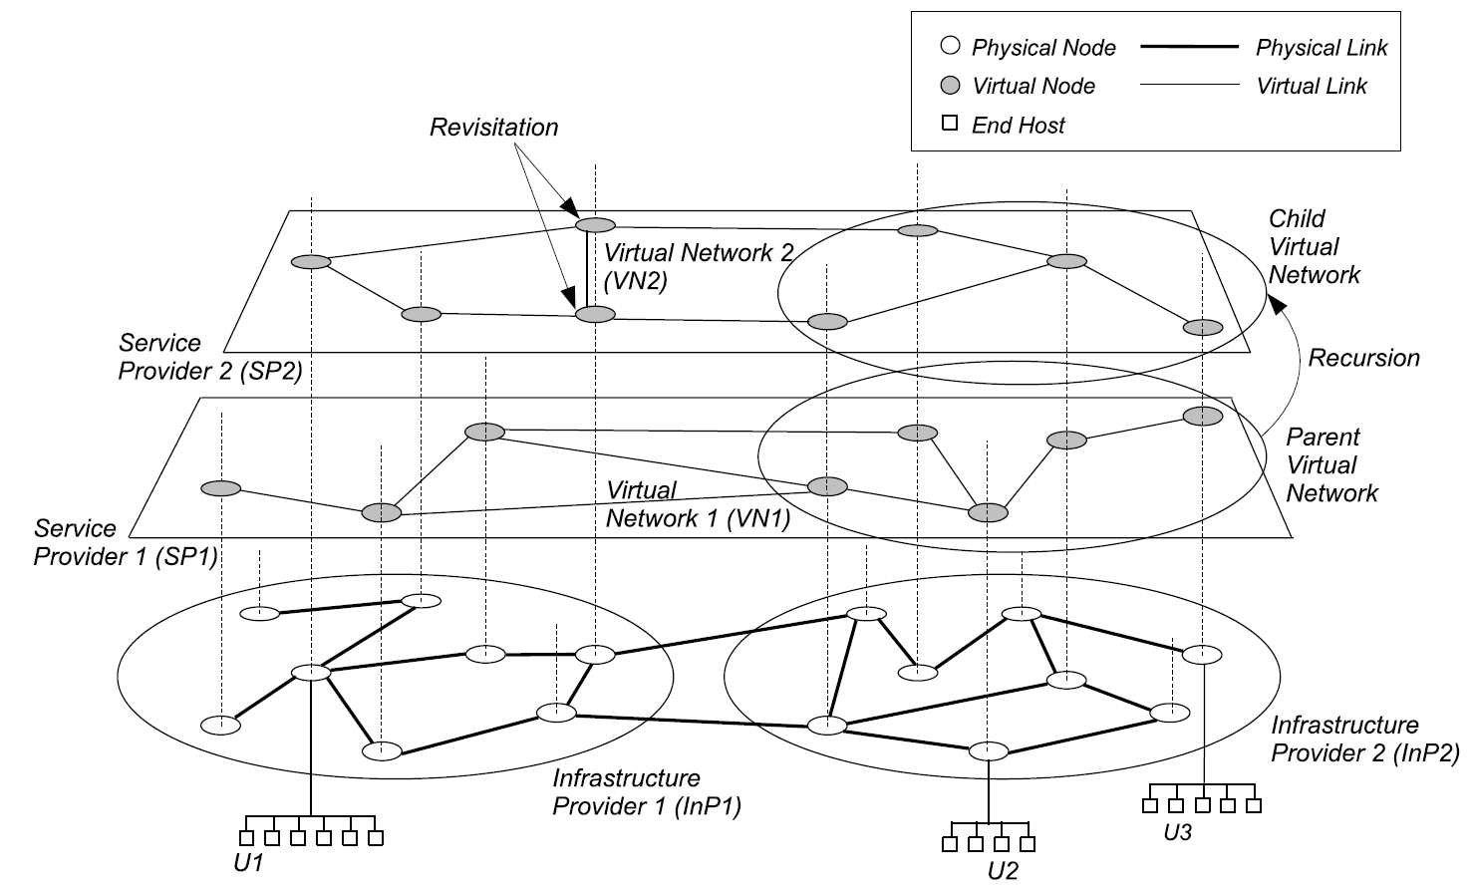
Architecture
CS854: Virtualization
Notes:
This figure shows an example of a network virtualization architecture.
Here two INPs control two physical networks, and two SPs have created two co-existing virtual networks by leasing resources from the INPs.
In addition, SP1 is also acting as a virtual INP, and has leased its resources to SP2 by creating a child VN.
This is known as recursion.
Child virtual networks also inherit attributes from the parent virtual networks, which is known as inheritance.
Moreover, in VN2 two nodes are actually located in the same physical node in the underlying network, which is known as revisitation.
End users are connected to the virtual networks, by first connecting to a INP.
These INPs are known as Access providers.

Slide 24
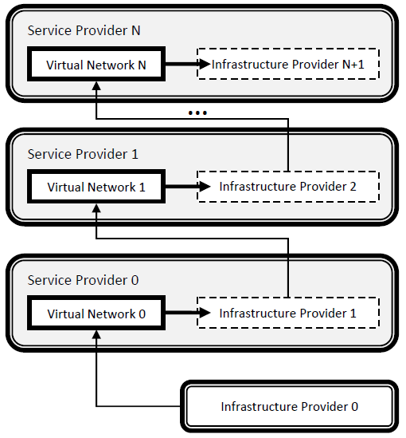
Hierarchy of Roles
CS854: Virtualization

Slide 25
Design Goals
Flexibility
  Service providers can choose
    arbitrary network topology,
    routing and forwarding functionalities,
    customized control and data planes
  No need for co-ordination with others
    IPv6 fiasco should never happen again
CS854: Virtualization
Notes:
Finally we have identified certain design goals that must be satisfied to realize a network virtualization environment.
<Read>

Slide 26
Design Goals (Cont.)
Manageability
  Clear separation of policy from mechanism
  Defined accountability of infrastructure and service providers
  Modular management
Scalability
  Maximize the number of co-existing virtual networks
  Increase resource utilization and amortize CAPEX and OPEX
CS854: Virtualization
Notes:
<Read>

Slide 27
Design Goals (Cont.)
Isolation
  Complete isolation between virtual networks
    Logical and resource
  Isolate faults and misconfigurations
Stability and Convergence
  Instability due to
    Errors and misconfigurations
    Instability in InP algorithms
  Quick convergence to stable state
CS854: Virtualization

Slide 28
Design Goals (Cont.)
Programmability
  Of network elements (e.g., routers)
  Answer “How much” and “how”
  Easy and effective without being vulnerable to threats
Heterogeneity
  Networking technologies
    Optical, sensor, wireless etc.
  Virtual networks
  End user devices
CS854: Virtualization
Notes:
<Read>

Slide 29
Design Goals (Cont.)
Experimental and Deployment Facility
  PlanetLab, GENI, VINI etc.
  Directly deploy services in real world from the testing phase
Legacy Support
  Consider the existing Internet as a member of the collection of multiple virtual Internets
  Very important to keep all concerned parties satisfied
CS854: Virtualization
Notes:
<Read>

Slide 30
What is Network Virtualization? (Revisited)
Network virtualization is a networking environment that allows multiple service providers to dynamically compose multiple heterogeneous virtual networks that coexist together in isolation from each other, and to deploy customized end-to-end services on-the-fly as well as manage them on those virtual networks for the end-users by effectively sharing and utilizing underlying network resources leased from multiple infrastructure providers.
CS854: Virtualization
Notes:
<Read>

Slide 31
Basic Concepts
Principles
Design Goals
Concurrence
Recursion
Inheritance
Revisitation
Flexibility
Manageability
Scalability
Isolation
Stability and Convergence
Programmability
Heterogeneity
Experimental and Deployment Facility
Legacy Support
CS854: Virtualization

Slide 32
Existing Projects
CS854: Virtualization

Slide 33
Classification
Networking technology
  Targeted technology for virtualization
Layer of virtualization
  Particular layer in the network stack where virtualization is introduced
Architectural domain
  Specific problem domain that virtualization addresses
Level of virtualization
  Granularity at which virtualization is realized
CS854: Virtualization

Slide 34
Existing Projects
Project | Architectural Domain | Networking Technology | Layer of Virtualization | Level of Virtualization
VNRMS | Virtual network management | ATM/IP |  | Node/Link
Tempest | Enabling alternate control architectures | ATM | Link
NetScript | Dynamic composition of services | IP | Network | Node
Genesis | Spawning virtual network architectures |  | Network | Node/Link
CS854: Virtualization

Slide 35
Existing Projects (Cont.)
Project | Architectural Domain | Networking Technology | Layer of Virtualization | Level of Virtualization
VNET | Virtual machine Grid computing |  | Link | Node
VIOLIN | Deploying on-demand value-added services on IP overlays | IP | Application | Node
X-Bone | Automating deployment of IP overlays | IP | Application | Node/Link
PlanetLab | Deploy and manage overlay-based testbeds | IP | Application | Node
UCLP | Dynamic provisioning and reconfiguration of lightpaths | SONET | Physical | Link
CS854: Virtualization

Slide 36
Existing Projects (Cont.)
Project | Architectural Domain | Networking Technology | Layer of Virtualization | Level of Virtualization
AGAVE | End-to-end QoS-aware service provisioning | IP | Network
GENI | Creating customized virtual network testbeds | Heterogeneous
VINI | Evaluating protocols and services in a realistic environment |  | Link
CABO | Deploying value-added end-to-end services on shared infrastructure | Heterogeneous |  | Full
CS854: Virtualization

Slide 37
Insights
Shift toward a holistic and generalized network virtualization environment that is
  Completely virtualized
    Virtualization of all network elements
  Highly customizable
    Virtualization at lower layers of the network stack
  Technology agnostic
    Support for heterogeneity
CS854: Virtualization

Slide 38
Future Directions
CS854: Virtualization

Slide 39
Future Directions
Instantiation
  Concerned with issues related to successful creation of virtual networks
Logistics
  Deals with operations of virtual networks and virtual components
Management
  Manages co-existing virtual networks
Interactions
  Handles interactions between players in the network virtualization environment
CS854: Virtualization

Slide 40
Instantiation
Interfacing
  Request format for a virtual network
  Make programmability of the network elements available
Signaling and Bootstrapping
  Request for a virtual network
  Bootstrap the customized network onto the physical network elements
  Use a separate network (e.g. Genesis) or out-of-band communication mechanism
CS854: Virtualization

Slide 41
Instantiation (Cont.)
Admission Control and Usage Policing
  Prohibit overbooking of network resources through admission control
  Distributed rate limiting
  Applied on complete virtual networks
Virtual Network Embedding
  Within single InP domain and across InP boundaries
  Known to be a NP-Hard problem
  Heuristic-based solutions
  Two versions of the problem
    Offline, where all the requests are known in advance
    Online, where requests arrive dynamically
CS854: Virtualization

Slide 42
Operation
Virtual Nodes
  Multiple logical routers inside one physical router
  Issues of interest
    Performance
    Scalability
    Migration (e.g. VROOM)
Virtual Links
  Similar to tunnels in VPNs
  Cross-InP virtual links
  Link scheduling (e.g. DaVinci)
CS854: Virtualization

Slide 43
Operation (Cont.)
Naming and Addressing
  Generic naming and addressing for all the virtual networks
  Überhoming
    Allows end users in a network virtualization environment to simultaneously connect to multiple VNs through multiple InPs using heterogeneous technologies to access different services.
  Identity-based routing
CS854: Virtualization

Slide 44
Operation (Cont.)
Resource Scheduling
  Maximize degree of co-existence
  Schedule CPU, Disk and Link b/w
Topology Discovery
  Within an InP administrative domain and across InP boundaries
  Event-based and periodic topology discovery (e.g., UCLP)
  Separate discovery plane (e.g., CABO)
CS854: Virtualization

Slide 45
Management
VN Configuration and Monitoring
  Enable virtualization from the level of NOCs to lower level network elements
    Concept of MIBlets (e.g., VNRMS)
Management Frameworks
  Generic management framework for the service providers
  Interface between multiple management paradigms
  Draw clear line between the management responsibilities of the InPs and the SPs
CS854: Virtualization

Slide 46
Management (Cont.)
Mobility Management
  Geographic mobility of the end user devices
  Mobility of the virtual routers through migration techniques
  Logical mobility of the end users in different virtual networks
Failure Handling
  Isolate failures
  Prevent cascading failures
CS854: Virtualization

Slide 47
Management (Cont.)
Self-*/Autonomic Properties
  Self-configuration and self-optimization for maximizing virtual resource utilization
  Self-protection and self-healing to survive malicious attacks
CS854: Virtualization

Slide 48
Interactions
Networking Technology Agnostic Virtualization
  Virtualization on and across optical, wireless, and sensor technology among other technologies
  Transparently create end-to-end virtual networks across heterogeneous technologies
Inter-VN Communication
  Sharing of resources and information between multiple virtual networks
  Creating compound virtual networks
CS854: Virtualization

Slide 49
Interactions (Cont.)
Tussles in the NVE
  Between multiple InPs
  Between InPs and SPs
Network Virtualization Economics
  Trade node resources (e.g. processing power, memory) in addition to bandwidth
  Centralized, decentralized and hybrid markets
CS854: Virtualization

Slide 50
Major Ongoing Projects
Project | Originated In | Link
4WARD | Europe | http://www.4ward-project.eu/
AKARI | Japan | http://akari-project.nict.go.jp/
CABO | USA | http://www.cs.princeton.edu/~jrex/virtual.html
Clean Slate | USA | http://cleanslate.stanford.edu/
GENI | USA | http://www.geni.net/
NouVeau | Canada | http://netlab.cs.uwaterloo.ca/virtual/
PlanetLab | USA | http://www.planet-lab.org/
Trilogy | Europe | http://www.trilogy-project.org/
UCLP | Canada | http://www.uclp.ca/
VINI | USA | http://www.vini-veritas.net/
CS854: Virtualization

Slide 51
Reference
N.M. Mosharaf Kabir Chowdhury, Raouf Boutaba, “A Survey of Network Virtualization”, University of Waterloo Technical Report CS-2008-25, Oct. 2008.
CS854: Virtualization

Slide 52
Questions ?
Mosharaf Chowdhury
http:// www.mosharaf.com/
CS854: Virtualization

Slide 53
Open Invitation
“Identity Management and Resource Allocation
in the Network Virtualization Environment”
@ DC 2314 from 3 PM on Jan 21st, 2009
CS854: Virtualization

